Slide 1
CS630 AI Agent Engineering Module 05 Experiencing Sessions & State Management
Core Concepts of Session, State, & Runner
Session Lifecycle
SessionService
Event Loop
State & Memory
Runner
Async Await in Python
Invocation Flow
Use Case, Class, & Deployment Diagram

Slide 2
Core Concepts
Think of different instances of your conversations with the agent as distinct conversation threads, potentially drawing upon long-term knowledge.
Session: The Current Conversation Thread
State (session.state): Data Within the Current Conversation
Memory: Searchable, Cross-Session Information
(Google, 2025)

Slide 3
Events, State, & Runner: Basketball Game Analogy
Session = The whole game
Think of a session as the entire basketball game. From the opening whistle to the final buzzer, everything that happens is part of that game session.
Events = Every play that happens
During the game, many things happen — someone dribbles, someone shoots, someone scores. Each of these is an event. They’re the building blocks of the game, just like events are the building blocks of what happens inside a session.
Runner = The referee and timekeeper combined
The runner makes sure the game is actually played. It starts the game, keeps it going, enforces the rules, and eventually ends it. Without the runner, the game (session) and the plays (events) would just be ideas, not reality.

Slide 4
Events, State, & Runner: Google ADK
Session is the structured container that tracks an individual conversation thread between a user and an agent.
An Event in ADK is an immutable record of a significant occurrence during the agent’s execution lifecycle—such as a user message, an agent reply, a tool invocation, state changes, errors, or control signals.
The Runner (also called the Runtime orchestrator) is the engine that drives the conversational flow.

Slide 5
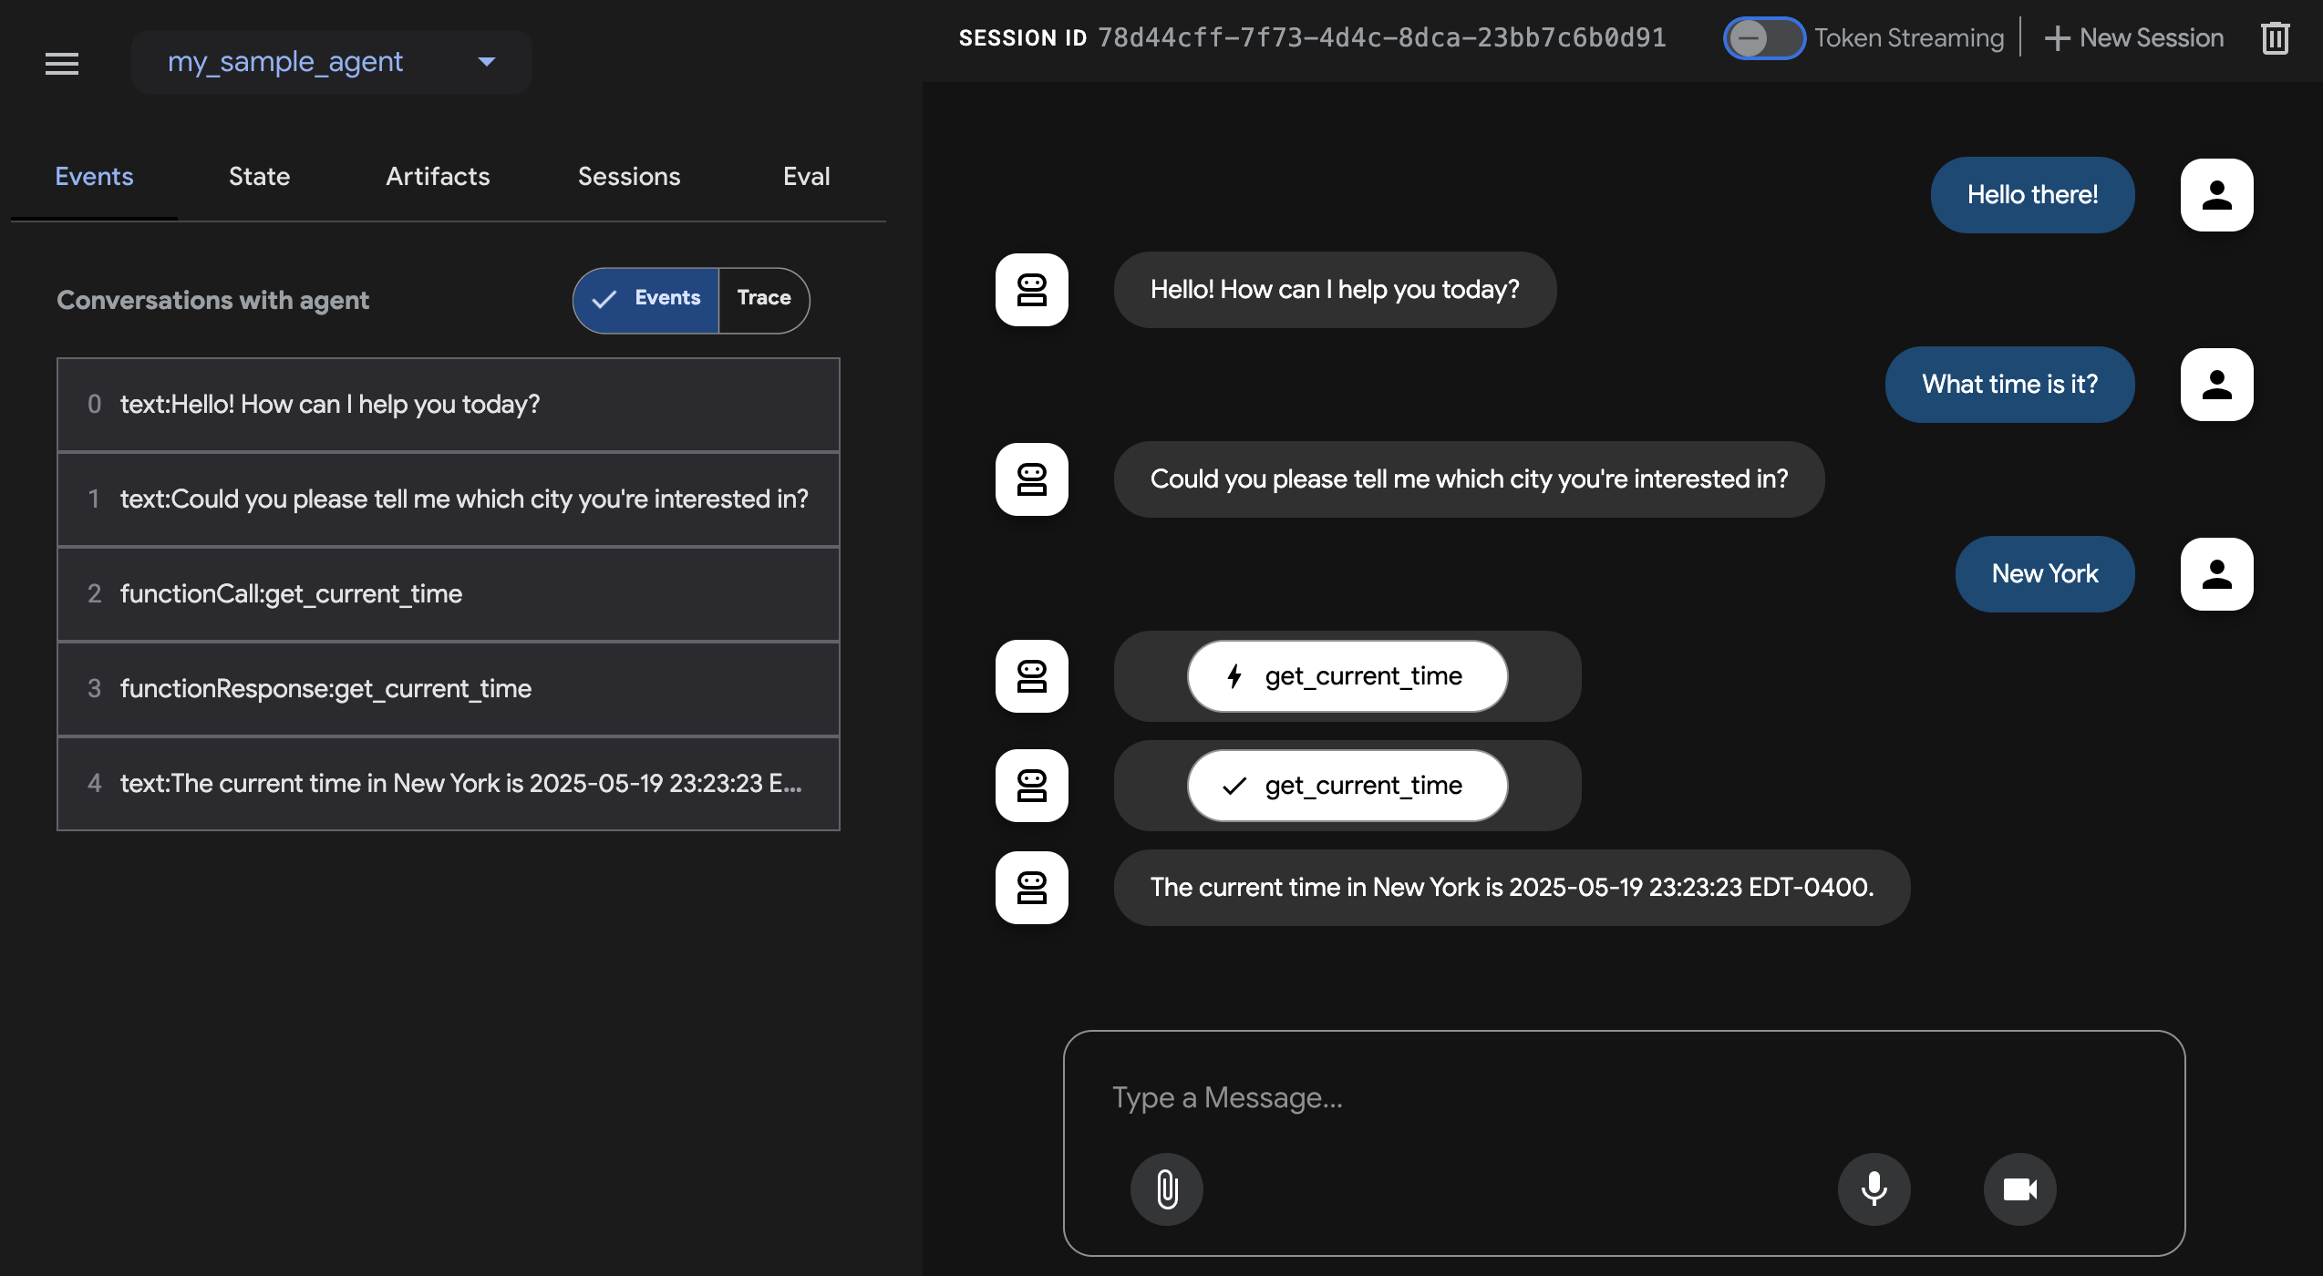
ADK WEB
Handles sessions, state, and runners
(Google, 2025)

Slide 6
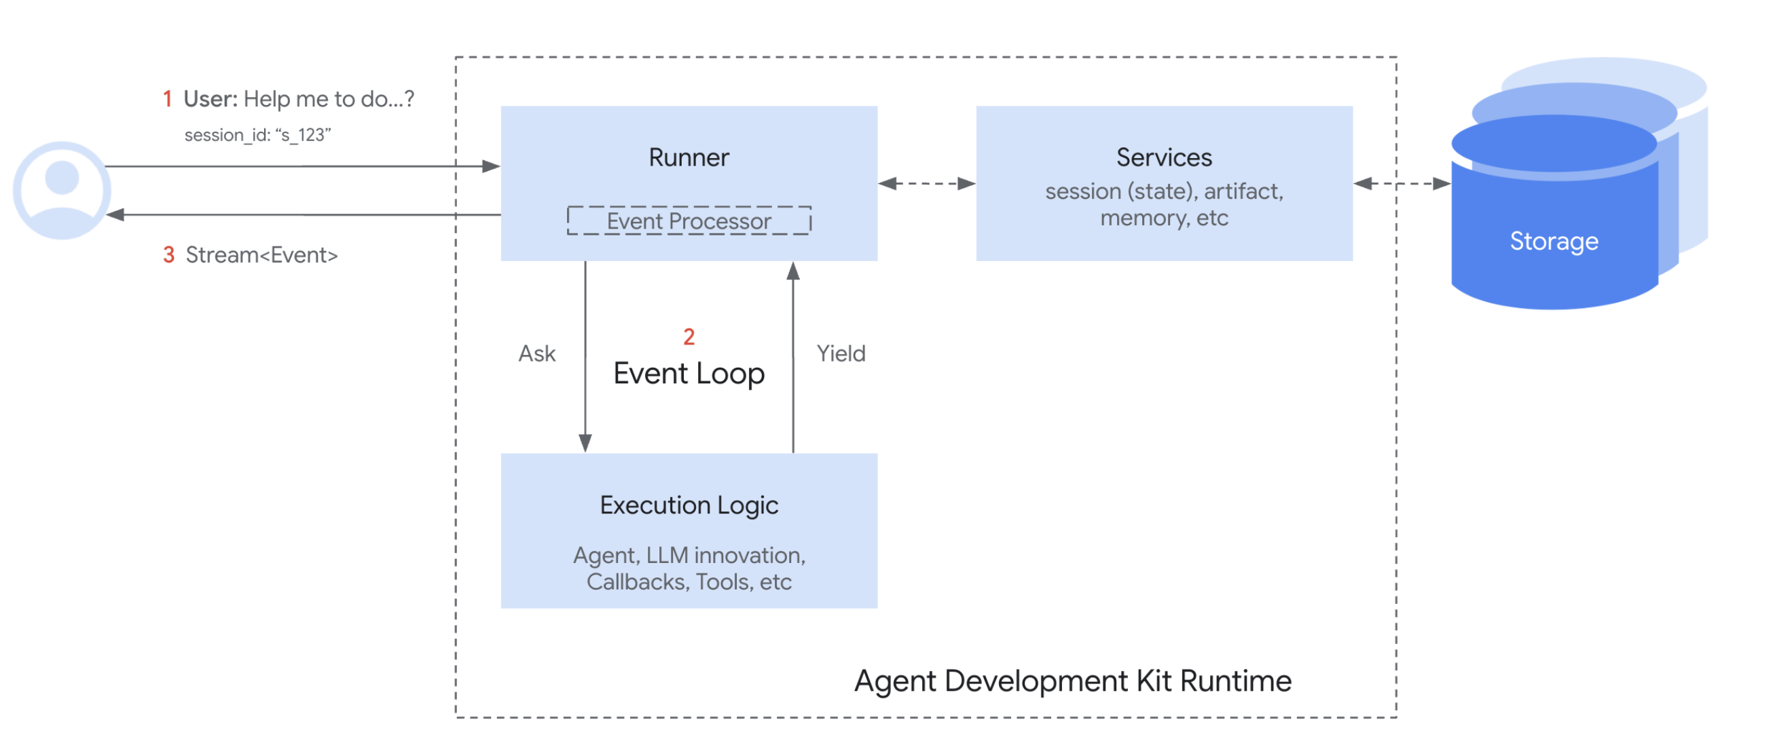
The Session Lifecycle
(Google, 2025)
Notes:
Here’s a simplified flow of how Session and SessionService work together during a conversation turn:
Start or Resume: Your application needs to use the SessionService to either create_session (for a new chat) or use an existing session id.
Context Provided: The Runner gets the appropriate Session object from the appropriate service method, providing the agent with access to the corresponding Session's state and events.
Agent Processing: The user prompts the agent with a query. The agent analyzes the query and potentially the session state and events history to determine the response.
Response & State Update: The agent generates a response (and potentially flags data to be updated in the state). The Runner packages this as an Event.
Save Interaction: The Runner calls sessionService.append_event(session, event) with the session and the new event as the arguments. The service adds the Event to the history and updates the session's state in storage based on information within the event. The session's last_update_time also get updated.
Ready for Next: The agent's response goes to the user. The updated Session is now stored by the SessionService, ready for the next turn (which restarts the cycle at step 1, usually with the continuation of the conversation in the current session).
End Conversation: When the conversation is over, your application calls sessionService.delete_session(...) to clean up the stored session data if it is no longer required.

Slide 7
Session: The Current Conversation Thread
Represents a single, ongoing interaction between a user and your agent system.
Contains the chronological sequence of messages and actions taken by the agent (referred to Events) during that specific interaction.
A Session can also hold temporary data (State) relevant only during this conversation.
(Google, 2025)

Slide 8
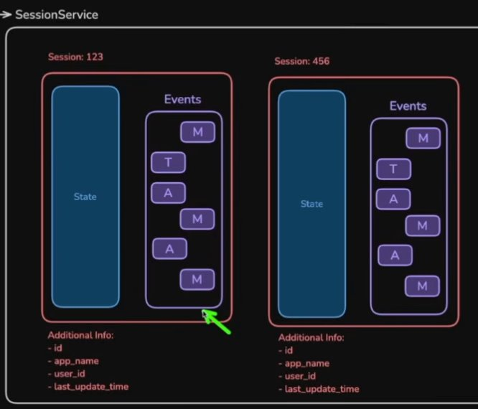
SessionService
(Hancock, 2025)

Slide 9
SessionService
InMemorySessionService – no persistence
DatabaseSessionService - persistence
VertexAISessionService – in the cloud
(Google, 2025)

Slide 10
State (session.state): Data Within the Current Conversation
Data stored within a specific Session.
Used to manage information relevant only to the current, active conversation thread (e.g., items in a shopping cart during this chat, user preferences mentioned in this session).
(Google, 2025)

Slide 11
Why Context Matters
Meaningful, multi-turn conversations require agents to understand context. Just like humans, they need to recall the conversation history: what's been said and done to maintain continuity and avoid repetition.
(Google, 2025)

Slide 12
The Session Object
When a user starts interacting with your agent, the SessionService creates a Session object (google.adk.sessions.Session). This object acts as the container holding everything related to that one specific chat thread. Here are its key properties:
Identification
History
Session State
Activity Tracking
(Google, 2025)
Notes:
When a user starts interacting with your agent, the SessionService creates a Session object (google.adk.sessions.Session). This object acts as the container holding everything related to that one specific chat thread. Here are its key properties:
Identification (id, appName, userId): Unique labels for the conversation.
id: A unique identifier for this specific conversation thread, essential for retrieving it later. A SessionService object can handle multiple Session(s). This field identifies which particular session object are we referring to. For example, "test_id_modification".
app_name: Identifies which agent application this conversation belongs to. For example, "id_modifier_workflow".
userId: Links the conversation to a particular user.
History (events): A chronological sequence of all interactions (Event objects – user messages, agent responses, tool actions) that have occurred within this specific thread.
Session State (state): A place to store temporary data relevant only to this specific, ongoing conversation. This acts as a scratchpad for the agent during the interaction. We will cover how to use and manage state in detail in the next section.
Activity Tracking (lastUpdateTime): A timestamp indicating the last time an event occurred in this conversation thread.
Example

Slide 13
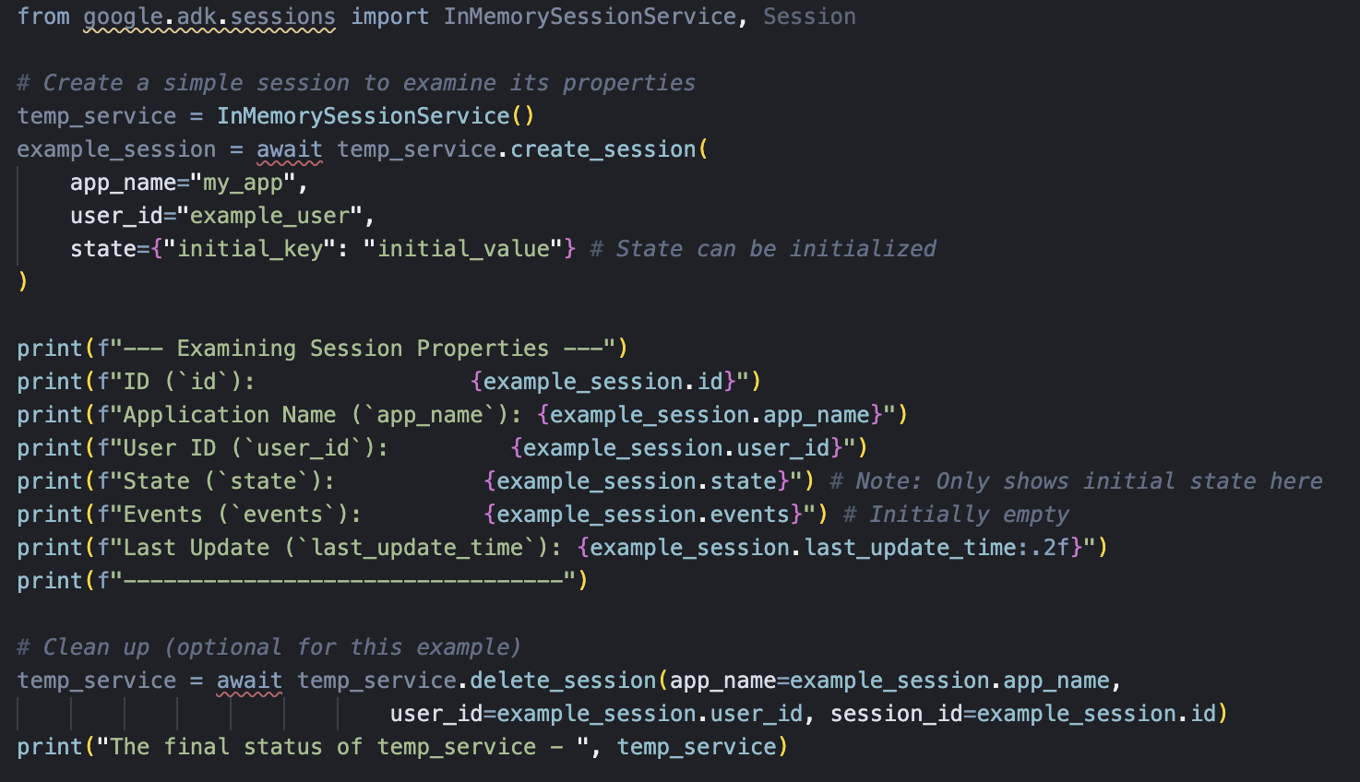
The Session Object
(Google, 2025)
Notes:
When a user starts interacting with your agent, the SessionService creates a Session object (google.adk.sessions.Session). This object acts as the container holding everything related to that one specific chat thread. Here are its key properties:
Identification (id, appName, userId): Unique labels for the conversation.
id: A unique identifier for this specific conversation thread, essential for retrieving it later. A SessionService object can handle multiple Session(s). This field identifies which particular session object are we referring to. For example, "test_id_modification".
app_name: Identifies which agent application this conversation belongs to. For example, "id_modifier_workflow".
userId: Links the conversation to a particular user.
History (events): A chronological sequence of all interactions (Event objects – user messages, agent responses, tool actions) that have occurred within this specific thread.
Session State (state): A place to store temporary data relevant only to this specific, ongoing conversation. This acts as a scratchpad for the agent during the interaction. We will cover how to use and manage state in detail in the next section.
Activity Tracking (lastUpdateTime): A timestamp indicating the last time an event occurred in this conversation thread.

Slide 14
Managing Context: Services
ADK provides services to manage these concepts:
SessionService: Manages the different conversation threads (Session objects)
Handles the lifecycle: creating, retrieving, updating (appending Events, modifying State), and deleting individual Sessions.
MemoryService: Manages the Long-Term Knowledge Store (Memory)
Handles ingesting information (often from completed Sessions) into the long-term store.
Provides methods to search this stored knowledge based on queries.
(Google, 2025)

Slide 15
The Event Loop
(Google, 2025)
Notes:
Core Idea: The Event Loop¶
At its heart, the ADK Runtime operates on an Event Loop. This loop facilitates a back-and-forth communication between the Runner component and your defined "Execution Logic" (which includes your Agents, the LLM calls they make, Callbacks, and Tools).
In simple terms:
The Runner receives a user query and asks the main Agent to start processing.
The Agent (and its associated logic) runs until it has something to report (like a response, a request to use a tool, or a state change) – it then yields or emits an Event.
The Runner receives this Event, processes any associated actions (like saving state changes via Services), and forwards the event onwards (e.g., to the user interface).
Only after the Runner has processed the event does the Agent's logic resume from where it paused, now potentially seeing the effects of the changes committed by the Runner.
This cycle repeats until the agent has no more events to yield for the current user query.
This event-driven loop is the fundamental pattern governing how ADK executes your agent code.

Slide 16
Events Examples
Message history between user and agents
Tool calling
Agent response
(Google, 2025)

Slide 17
Events as central to ADK's operation
Communication: They serve as the standard message format between the user interface, the Runner, agents, the LLM, and tools. Everything flows as an Event.
Signaling State & Artifact Changes: Events carry instructions for state modifications and track artifact updates.
Control Flow: act as signals that direct the framework, determining which agent runs next or if a loop should terminate.
History & Observability: The sequence of events recorded in session.events provides a complete, chronological history of an interaction, invaluable for debugging, auditing, and understanding agent behavior step-by-step.
Notes:
Communication: They serve as the standard message format between the user interface, the Runner, agents, the LLM, and tools. Everything flows as an Event.
Signaling State & Artifact Changes: Events carry instructions for state modifications and track artifact updates. The SessionService uses these signals to ensure persistence. In Python changes are signaled via event.actions.state_delta and event.actions.artifact_delta.
Control Flow: Specific fields like event.actions.transfer_to_agent or event.actions.escalate act as signals that direct the framework, determining which agent runs next or if a loop should terminate.
History & Observability: The sequence of events recorded in session.events provides a complete, chronological history of an interaction, invaluable for debugging, auditing, and understanding agent behavior step-by-step.

Slide 18
Events
# Conceptual Structure of an Event (Python) # from google.adk.events import Event, EventActions # from google.genai import types # class Event(LlmResponse): # Simplified view # # --- LlmResponse fields --- # content: Optional[types.Content] # partial: Optional[bool] # # ... other response fields ... # # --- ADK specific additions --- # author: str # 'user' or agent name # invocation_id: str # ID for the whole interaction run # id: str # Unique ID for this specific event # timestamp: float # Creation time # actions: EventActions # Important for side-effects & control # branch: Optional[str] # Hierarchy path # # ...
Notes:
The provided code snippet outlines the conceptual structure of an Event in the Google Agent Development Kit (ADK) for Python. An Event represents a single, discrete unit of action or thought generated by the agent during its execution. Think of it as a snapshot of what the agent is doing at a particular moment in time.
Core Concepts
The Event class is built upon LlmResponse and adds several key fields to provide a comprehensive record of the agent's actions within a session. The Event class is a crucial part of the ADK's streaming and asynchronous nature, allowing developers to see the agent's progress in real-time.
Inheritance from LlmResponse: The Event class inherits from LlmResponse (Large Language Model Response). This means every event can carry information directly from the underlying LLM, such as the content of a message or whether the response is partial (still being generated).
ADK-Specific Additions: These are the fields that make an Event a powerful ADK primitive:
author: This field identifies who or what generated the event, such as a 'user' or the agent itself (e.g., 'question_answering_agent').
invocation_id: This unique ID tracks the entire end-to-end conversation or "run." All events from a single runner.run_async() call will share the same invocation_id.
id: This is a unique ID for the specific event itself.
timestamp: Records the exact time the event was created.
actions: This is a critical field that represents the side-effects or actions associated with the event. For example, an EventActions object can contain a list of ToolCalls the agent decided to make or a flag indicating a Stop action to terminate the execution. This field is the bridge between the agent's thought process and the external world.
branch: This optional field helps to organize events in a nested or hierarchical structure, particularly when the agent explores different paths or branches of reasoning.

Slide 19
Identifying Event Origin and Type
Who sent it? (event.author)
'user': Indicates input directly from the end-user.
'AgentName': Indicates output or action from a specific agent (e.g., 'WeatherAgent', 'SummarizerAgent').
What's the main payload? (event.content and event.content.parts)
Text: Indicates a conversational message. For Python, check if event.content.parts[0].text exists. For Java, check if event.content() is present, its parts() are present and not empty, and the first part's text() is present.
Tool Call Request: Check event.get_function_calls(). If not empty, the LLM is asking to execute one or more tools. Each item in the list has .name and .args.
Tool Result: Check event.get_function_responses(). If not empty, this event carries the result(s) from tool execution(s). Each item has .name and .response (the dictionary returned by the tool). Note: For history structuring, the role inside the content is often 'user', but the event author is typically the agent that requested the tool call.
Is it streaming output? (event.partial) Indicates whether this is an incomplete chunk of text from the LLM.
True: More text will follow.
False or None/Optional.empty(): This part of the content is complete (though the overall turn might not be finished if turn_complete is also false).
Notes:
Understanding and Using Events
As a developer, you'll primarily interact with the stream of events yielded by the Runner. Here's how to understand and extract information from them:

Slide 20
Events
# Pseudocode: Basic event identification (Python) # async for event in runner.run_async(...): # print(f"Event from: {event.author}") # # if event.content and event.content.parts: # if event.get_function_calls(): # print(" Type: Tool Call Request") # elif event.get_function_responses(): # print(" Type: Tool Result") # elif event.content.parts[0].text: # if event.partial: # print(" Type: Streaming Text Chunk") # else: # print(" Type: Complete Text Message") # else: # print(" Type: Other Content (e.g., code result)") # elif event.actions and (event.actions.state_delta or event.actions.artifact_delta): # print(" Type: State/Artifact Update") # else: # print(" Type: Control Signal or Other")
Notes:
This code acts like a detective, examining a stream of events from an agent to figure out what it's doing.
The main part of the code is an async for loop that processes each event as it comes in. Inside the loop, it uses a series of if/elif statements to identify the event's purpose:
if event.get_function_calls(): This event signals that the agent has decided to use a tool. It's like the agent is saying, "I need to call an external function," and this event provides the details of that request.
elif event.get_function_responses(): After a tool call is complete, this event arrives with the result. It's the agent's way of getting the information it needs to continue working on a problem.
elif event.content and event.content.parts[0].text: This condition is for any event that contains text. It's a broad category, so the code checks for more specific types of text events.
if event.partial: If this is true, the event is just a small chunk of text from a larger, streaming response. It's what allows a user interface to display the agent's answer as it's being generated, character by character.
else: This means the event contains a complete block of text, which could be an internal thought or the final, full response to the user.
elif event.actions and (event.actions.state_delta or event.actions.artifact_delta): This event tells us that the agent has updated its internal memory. It could be changing a value in its short-term state or adding new information to its long-term knowledge.
else: This is a final catch-all for any other event, such as a control signal that tells the agent to stop or a special event related to its internal thought process.

Slide 21
State vs Memory
State is short term memory
Store information on a dictionary
Initial state == initial values
Memory is long term knowledge
Persistence
Ingestion
Retrieval
(Google, 2025)

Slide 22
Memory: Searchable, Cross-Session Information
Represents a store of information that might span multiple past sessions or include external data sources.
It acts as a knowledge base the agent can search to recall information or context beyond the immediate conversation.
(Google, 2025)

Slide 23
Summary of Session, State, & Memory
Session & State: Focus on the current interaction – the history and data of the single, active conversation. Managed primarily by a SessionService.
Memory: Focuses on the past and external information – a searchable archive potentially spanning across conversations. Managed by a MemoryService.
(Google, 2025)

Slide 24
Managing Sessions with a SessionService
Core responsibilities:
Starting New Conversations
Resuming Existing Conversations
Saving Progress
Listing Conversations
Cleaning Up
(Google, 2025)
Notes:
As seen above, you don't typically create or manage Session objects directly. Instead, you use a SessionService. This service acts as the central manager responsible for the entire lifecycle of your conversation sessions.
Its core responsibilities include:
Starting New Conversations: Creating fresh Session objects when a user begins an interaction.
Resuming Existing Conversations: Retrieving a specific Session (using its ID) so the agent can continue where it left off.
Saving Progress: Appending new interactions (Event objects) to a session's history. This is also the mechanism through which session state gets updated (more in the State section).
Listing Conversations: Finding the active session threads for a particular user and application.
Cleaning Up: Deleting Session objects and their associated data when conversations are finished or no longer needed.

Slide 25
SessionService Implementations
 | InMemorySessionService | VertexAiSessionService | DatabaseSessionService
How it works | Stored in app memory | Uses Vertex AI infra via API call | Connects to a relational DB
Persistence | No | Yes | Yes
Requires | Nothing | GCP project, GCP storage bucket, Reasoning Engine | Configured DB
Best for | Quick development, local testing | Scalable production applications | Apps needing persistent storage that you manage by yourself
(Google, 2025)
Notes:
SessionService Implementations¶
ADK provides different SessionService implementations, allowing you to choose the storage backend that best suits your needs:
InMemorySessionService
How it works: Stores all session data directly in the application's memory.
Persistence: None. All conversation data is lost if the application restarts.
Requires: Nothing extra.
Best for: Quick development, local testing, examples, and scenarios where long-term persistence isn't required.
Python
Java
from google.adk.sessions import InMemorySessionService session_service = InMemorySessionService()
VertexAiSessionService
How it works: Uses Google Cloud's Vertex AI infrastructure via API calls for session management.
Persistence: Yes. Data is managed reliably and scalably via Vertex AI Agent Engine.
Requires:
A Google Cloud project (pip install vertexai)
A Google Cloud storage bucket that can be configured by this step.
A Reasoning Engine resource name/ID that can setup following this tutorial.
If you do not have a Google Cloud project and you want to try the VertexAiSessionService for free, see how to try Session and Memory for free.
Best for: Scalable production applications deployed on Google Cloud, especially when integrating with other Vertex AI features.
Python
Java
# Requires: pip install google-adk[vertexai] # Plus GCP setup and authentication from google.adk.sessions import VertexAiSessionService PROJECT_ID = "your-gcp-project-id" LOCATION = "us-central1" # The app_name used with this service should be the Reasoning Engine ID or name REASONING_ENGINE_APP_NAME = "projects/your-gcp-project-id/locations/us-central1/reasoningEngines/your-engine-id" session_service = VertexAiSessionService(project=PROJECT_ID, location=LOCATION) # Use REASONING_ENGINE_APP_NAME when calling service methods, e.g.: # session_service = await session_service.create_session(app_name=REASONING_ENGINE_APP_NAME, ...)
DatabaseSessionService
How it works: Connects to a relational database (e.g., PostgreSQL, MySQL, SQLite) to store session data persistently in tables.
Persistence: Yes. Data survives application restarts.
Requires: A configured database.
Best for: Applications needing reliable, persistent storage that you manage yourself.
from google.adk.sessions import DatabaseSessionService # Example using a local SQLite file: db_url = "sqlite:///./my_agent_data.db" session_service = DatabaseSessionService(db_url=db_url)
Choosing the right SessionService is key to defining how your agent's conversation history and temporary data are stored and persist.

Slide 26
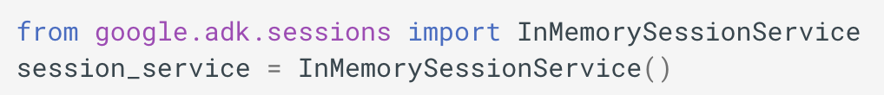
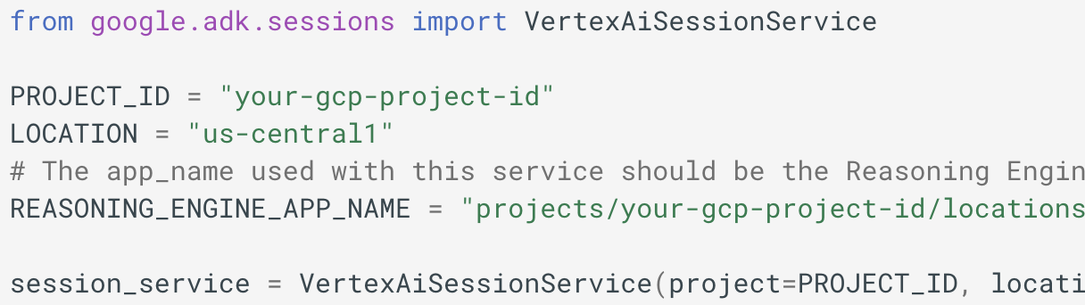
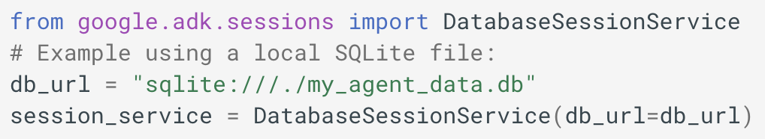
SessionService Implementations Examples
(Google, 2025)
Notes:
SessionService Implementations¶
ADK provides different SessionService implementations, allowing you to choose the storage backend that best suits your needs:
InMemorySessionService
How it works: Stores all session data directly in the application's memory.
Persistence: None. All conversation data is lost if the application restarts.
Requires: Nothing extra.
Best for: Quick development, local testing, examples, and scenarios where long-term persistence isn't required.
Python
Java
from google.adk.sessions import InMemorySessionService session_service = InMemorySessionService()
VertexAiSessionService
How it works: Uses Google Cloud's Vertex AI infrastructure via API calls for session management.
Persistence: Yes. Data is managed reliably and scalably via Vertex AI Agent Engine.
Requires:
A Google Cloud project (pip install vertexai)
A Google Cloud storage bucket that can be configured by this step.
A Reasoning Engine resource name/ID that can setup following this tutorial.
If you do not have a Google Cloud project and you want to try the VertexAiSessionService for free, see how to try Session and Memory for free.
Best for: Scalable production applications deployed on Google Cloud, especially when integrating with other Vertex AI features.
Python
Java
# Requires: pip install google-adk[vertexai] # Plus GCP setup and authentication from google.adk.sessions import VertexAiSessionService PROJECT_ID = "your-gcp-project-id" LOCATION = "us-central1" # The app_name used with this service should be the Reasoning Engine ID or name REASONING_ENGINE_APP_NAME = "projects/your-gcp-project-id/locations/us-central1/reasoningEngines/your-engine-id" session_service = VertexAiSessionService(project=PROJECT_ID, location=LOCATION) # Use REASONING_ENGINE_APP_NAME when calling service methods, e.g.: # session_service = await session_service.create_session(app_name=REASONING_ENGINE_APP_NAME, ...)
DatabaseSessionService
How it works: Connects to a relational database (e.g., PostgreSQL, MySQL, SQLite) to store session data persistently in tables.
Persistence: Yes. Data survives application restarts.
Requires: A configured database.
Best for: Applications needing reliable, persistent storage that you manage yourself.
from google.adk.sessions import DatabaseSessionService # Example using a local SQLite file: db_url = "sqlite:///./my_agent_data.db" session_service = DatabaseSessionService(db_url=db_url)
Choosing the right SessionService is key to defining how your agent's conversation history and temporary data are stored and persist.

Slide 27
What is runtime?
Think of the Runtime as the "engine" of your agentic application. You define the parts (agents, tools), and the Runtime handles how they connect and run together to fulfill a user's request.
(Google, 2025)
Notes:
What is runtime?
The ADK Runtime is the underlying engine that powers your agent application during user interactions. It's the system that takes your defined agents, tools, and callbacks and orchestrates their execution in response to user input, managing the flow of information, state changes, and interactions with external services like LLMs or storage.
Think of the Runtime as the "engine" of your agentic application. You define the parts (agents, tools), and the Runtime handles how they connect and run together to fulfill a user's request.
Runner's Role (Orchestrator)¶
The Runner acts as the central coordinator for a single user invocation. Its responsibilities in the loop are:
Initiation: Receives the end user's query (new_message) and typically appends it to the session history via the SessionService.
Kick-off: Starts the event generation process by calling the main agent's execution method (e.g., agent_to_run.run_async(...)).
Receive & Process: Waits for the agent logic to yield or emit an Event. Upon receiving an event, the Runner promptly processes it. This involves:
Using configured Services (SessionService, ArtifactService, MemoryService) to commit changes indicated in event.actions (like state_delta, artifact_delta).
Performing other internal bookkeeping.
Yield Upstream: Forwards the processed event onwards (e.g., to the calling application or UI for rendering).
Iterate: Signals the agent logic that processing is complete for the yielded event, allowing it to resume and generate the next event.

Slide 28
Runner's Role (Orchestrator)
The Runner acts as the central coordinator for a single user invocation.
Initiation
Kick-off
Receive & Process
Yield Upstream
Iterate
(Google, 2025)
Notes:
Runner's Role (Orchestrator)
The Runner acts as the central coordinator for a single user invocation. Its responsibilities in the loop are:
Initiation: Receives the end user's query (new_message) and typically appends it to the session history via the SessionService.
Kick-off: Starts the event generation process by calling the main agent's execution method (e.g., agent_to_run.run_async(...)).
Receive & Process: Waits for the agent logic to yield or emit an Event. Upon receiving an event, the Runner promptly processes it. This involves:
Using configured Services (SessionService, ArtifactService, MemoryService) to commit changes indicated in event.actions (like state_delta, artifact_delta).
Performing other internal bookkeeping.
Yield Upstream: Forwards the processed event onwards (e.g., to the calling application or UI for rendering).
Iterate: Signals the agent logic that processing is complete for the yielded event, allowing it to resume and generate the next event.

Slide 29
Runner's Role (Orchestrator)
# Simplified view of Runner's main loop logic def run(new_query, ...) -> Generator[Event]: # 1. Append new_query to session event history (via SessionService) session_service.append_event(session, Event(author='user', content=new_query)) # 2. Kick off event loop by calling the agent agent_event_generator = agent_to_run.run_async(context) async for event in agent_event_generator: # 3. Process the generated event and commit changes session_service.append_event(session, event) # Commits state/artifact deltas etc. # memory_service.update_memory(...) # If applicable # artifact_service might have already been called via context during agent run # 4. Yield event for upstream processing (e.g., UI rendering) yield event # Runner implicitly signals agent generator can continue after yielding
(Google, 2025)
Notes:
Runner's Role (Orchestrator)
The Runner acts as the central coordinator for a single user invocation. Its responsibilities in the loop are:
Initiation: Receives the end user's query (new_message) and typically appends it to the session history via the SessionService.
Kick-off: Starts the event generation process by calling the main agent's execution method (e.g., agent_to_run.run_async(...)).
Receive & Process: Waits for the agent logic to yield or emit an Event. Upon receiving an event, the Runner promptly processes it. This involves:
Using configured Services (SessionService, ArtifactService, MemoryService) to commit changes indicated in event.actions (like state_delta, artifact_delta).
Performing other internal bookkeeping.
Yield Upstream: Forwards the processed event onwards (e.g., to the calling application or UI for rendering).
Iterate: Signals the agent logic that processing is complete for the yielded event, allowing it to resume and generate the next event.

Slide 30
Async Await in Python
Async programming allows tasks to run concurrently without blocking each other.
Use it when waiting for I/O (e.g., web requests, database calls, file reads).
async defines a coroutine (special function).
await pauses execution until the awaited task completes.
Unlike threads, it uses a single thread and an event loop, making it lightweight.
Notes:
“Python’s async and await are all about handling tasks that wait a lot — like web requests, database queries, or reading files. Normally, Python would block and just sit there until the task finishes. But with async, it can keep working on other things while it waits.
When I mark a function with async, I’m saying: this is a coroutine, it can pause and resume later. Then, when I use await, that’s where the pause actually happens — the function waits there, and the event loop gives time to other tasks.”

Slide 31
Async Await Example in Python
import asyncio async def fetch_data(): print("Start fetching...") await asyncio.sleep(2) # simulates I/O print("Done fetching!") return {"data": 123} async def main(): result = await fetch_data() print(result) asyncio.run(main())
Output:
Start fetching... ...2 sec pause... Done fetching! {'data': 123}
(Google, 2025
Notes:
“In this example, fetch_data simulates fetching something from the internet. The await asyncio.sleep(2) line is just a fake 2-second delay, but imagine it’s waiting for a website to respond.
Notice that Python doesn’t freeze the entire program — it just pauses that coroutine. Once the wait is over, it continues, prints ‘Done fetching’, and returns the data.
Finally, in main(), we await the result of fetch_data, and asyncio.run(main()) kicks off the event loop.”
(Wrap-up key point) “So the big takeaway is: async and await make Python efficient at juggling many I/O tasks at once, without needing heavy multi-threading.”

Slide 32
Async Await Example in Python
# Define the main function to run the agent async def run_agent(): # Create session, initialize runner session_service = InMemorySessionService() session_id = str(uuid.uuid4()) await session_service.create_session("Brandon Bot", "brandon_hancock", session_id, initial_state) runner = Runner(agent=question_answering_agent, app_name="Brandon Bot", session_service=session_service) # Run the agent with a new message user_message = types.Content(role="user", parts=[types.Part(text="What is Brandon's favorite TV show?")]) async for event in runner.run_async(user_id="brandon_hancock", session_id=session_id, new_message=user_message): if event.is_final_response(): print(f"Final Response: {event.content.parts[0].text}") # Display final state session = await session_service.get_session("Brandon Bot", "brandon_hancock", session_id) print("\nFinal Session State:") for key, value in session.state.items(): print(f" - {key}: {value}") # Run the main function if __name__ == "__main__": asyncio.run(run_agent())
Notes:
This block of code is the core of the Google ADK example. It orchestrates the entire process of setting up a conversational session, running an agent, and then inspecting the results.
Here's a step-by-step breakdown of what each section does:
1. async def run_agent():
async def run_agent():: This defines an async (asynchronous) function. Asynchronous programming is used here because many of the operations, like creating a session or running the agent, involve waiting for I/O (Input/Output) or external services to respond. The await keyword pauses the function until the operation is complete, without blocking the entire program.
2. Session and Runner Initialization
session_service = InMemorySessionService(): This line creates a new instance of the InMemorySessionService. This is a simple, non-persistent session service provided by the ADK. It stores all session-related data (like "state") in RAM, so the data is lost when the program ends. For production, you would use a persistent service like a database or a file system.
session_id = str(uuid.uuid4()): This generates a unique identifier for the current conversational session. A UUID (Universally Unique Identifier) ensures that this session is distinct from any others.
await session_service.create_session(...): This is a crucial step. It tells the session_service to create a new session.
"Brandon Bot": The name of the application.
"brandon_hancock": A unique identifier for the user.
session_id: The unique ID for this specific conversation.
initial_state: This is where you inject the pre-defined initial_state dictionary (the one with user_name and user_preferences). This populates the agent's short-term memory (state) right from the start.
runner = Runner(...): This line initializes the Runner, which is the component responsible for executing the agent.
agent=question_answering_agent: It links the runner to the specific Agent object we defined earlier.
app_name="Brandon Bot": Specifies the application name again.
session_service=session_service: It tells the runner which session service to use for managing conversational state.
3. Running the Agent
user_message = types.Content(...): This creates the message that will be sent to the agent. It's a standard ADK Content object.
role="user": Identifies the sender as the user.
parts=[types.Part(text="What is Brandon's favorite TV show?")]: The actual text of the user's query.
async for event in runner.run_async(...): This is the main execution loop.
runner.run_async(...): This is the method that starts the agent's process. It takes the user's ID, the session ID, and the new message as input.
The method is an async generator, which means it doesn't return a single result. Instead, it yields a stream of "events" as the agent's thoughts and actions unfold (e.g., tool calls, intermediate thoughts, etc.). This is why we use an async for loop to iterate through them.
if event.is_final_response():: This checks if the current event is the final, user-facing response from the agent.
print(f"Final Response: {event.content.parts[0].text}"): If it is the final response, this line prints the text of that response.
4. Displaying Final State
session = await session_service.get_session(...): After the agent has finished its work and the loop is complete, this line retrieves the final state of the session from the session service. This allows us to see if the agent modified or added any new information to its state during the conversation.
print(...): This block simply iterates through the key-value pairs in the session's state dictionary and prints them out, showing the state of the agent's short-term memory after the conversation is complete.
5. Running the Function
if __name__ == "__main__":: This is standard Python boilerplate that ensures the code inside the block only runs when the script is executed directly (not when it's imported as a module).
asyncio.run(run_agent()): This is the command that starts the entire asynchronous process. It takes our run_agent() function and executes it, handling all the asynchronous logic in the background.

Slide 33
Invocation Flow
See full image here:
https://google.github.io/adk-docs/assets/invocation-flow.png
(Google, 2025)
Notes:
Step-by-Step Breakdown¶
User Input: The User sends a query (e.g., "What's the capital of France?").
Runner Starts: Runner.run_async begins. It interacts with the SessionService to load the relevant Session and adds the user query as the first Event to the session history. An InvocationContext (ctx) is prepared.
Agent Execution: The Runner calls agent.run_async(ctx) on the designated root agent (e.g., an LlmAgent).
LLM Call (Example): The Agent_Llm determines it needs information, perhaps by calling a tool. It prepares a request for the LLM. Let's assume the LLM decides to call MyTool.
Yield FunctionCall Event: The Agent_Llm receives the FunctionCall response from the LLM, wraps it in an Event(author='Agent_Llm', content=Content(parts=[Part(function_call=...)])), and yields or emits this event.
Agent Pauses: The Agent_Llm's execution pauses immediately after the yield.
Runner Processes: The Runner receives the FunctionCall event. It passes it to the SessionService to record it in the history. The Runner then yields the event upstream to the User (or application).
Agent Resumes: The Runner signals that the event is processed, and Agent_Llm resumes execution.
Tool Execution: The Agent_Llm's internal flow now proceeds to execute the requested MyTool. It calls tool.run_async(...).
Tool Returns Result: MyTool executes and returns its result (e.g., {'result': 'Paris'}).
Yield FunctionResponse Event: The agent (Agent_Llm) wraps the tool result into an Event containing a FunctionResponse part (e.g., Event(author='Agent_Llm', content=Content(role='user', parts=[Part(function_response=...)]))). This event might also contain actions if the tool modified state (state_delta) or saved artifacts (artifact_delta). The agent yields this event.
Agent Pauses: Agent_Llm pauses again.
Runner Processes: Runner receives the FunctionResponse event. It passes it to SessionService which applies any state_delta/artifact_delta and adds the event to history. Runner yields the event upstream.
Agent Resumes: Agent_Llm resumes, now knowing the tool result and any state changes are committed.
Final LLM Call (Example): Agent_Llm sends the tool result back to the LLM to generate a natural language response.
Yield Final Text Event: Agent_Llm receives the final text from the LLM, wraps it in an Event(author='Agent_Llm', content=Content(parts=[Part(text=...)])), and yields it.
Agent Pauses: Agent_Llm pauses.
Runner Processes: Runner receives the final text event, passes it to SessionService for history, and yields it upstream to the User. This is likely marked as the is_final_response().
Agent Resumes & Finishes: Agent_Llm resumes. Having completed its task for this invocation, its run_async generator finishes.
Runner Completes: The Runner sees the agent's generator is exhausted and finishes its loop for this invocation.

Slide 34
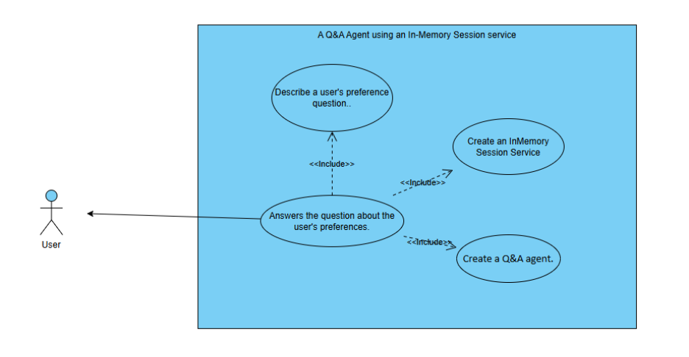
Use Case Diagram
Notes:
Step-by-Step Breakdown¶
User Input: The User sends a query (e.g., "What's the capital of France?").
Runner Starts: Runner.run_async begins. It interacts with the SessionService to load the relevant Session and adds the user query as the first Event to the session history. An InvocationContext (ctx) is prepared.
Agent Execution: The Runner calls agent.run_async(ctx) on the designated root agent (e.g., an LlmAgent).
LLM Call (Example): The Agent_Llm determines it needs information, perhaps by calling a tool. It prepares a request for the LLM. Let's assume the LLM decides to call MyTool.
Yield FunctionCall Event: The Agent_Llm receives the FunctionCall response from the LLM, wraps it in an Event(author='Agent_Llm', content=Content(parts=[Part(function_call=...)])), and yields or emits this event.
Agent Pauses: The Agent_Llm's execution pauses immediately after the yield.
Runner Processes: The Runner receives the FunctionCall event. It passes it to the SessionService to record it in the history. The Runner then yields the event upstream to the User (or application).
Agent Resumes: The Runner signals that the event is processed, and Agent_Llm resumes execution.
Tool Execution: The Agent_Llm's internal flow now proceeds to execute the requested MyTool. It calls tool.run_async(...).
Tool Returns Result: MyTool executes and returns its result (e.g., {'result': 'Paris'}).
Yield FunctionResponse Event: The agent (Agent_Llm) wraps the tool result into an Event containing a FunctionResponse part (e.g., Event(author='Agent_Llm', content=Content(role='user', parts=[Part(function_response=...)]))). This event might also contain actions if the tool modified state (state_delta) or saved artifacts (artifact_delta). The agent yields this event.
Agent Pauses: Agent_Llm pauses again.
Runner Processes: Runner receives the FunctionResponse event. It passes it to SessionService which applies any state_delta/artifact_delta and adds the event to history. Runner yields the event upstream.
Agent Resumes: Agent_Llm resumes, now knowing the tool result and any state changes are committed.
Final LLM Call (Example): Agent_Llm sends the tool result back to the LLM to generate a natural language response.
Yield Final Text Event: Agent_Llm receives the final text from the LLM, wraps it in an Event(author='Agent_Llm', content=Content(parts=[Part(text=...)])), and yields it.
Agent Pauses: Agent_Llm pauses.
Runner Processes: Runner receives the final text event, passes it to SessionService for history, and yields it upstream to the User. This is likely marked as the is_final_response().
Agent Resumes & Finishes: Agent_Llm resumes. Having completed its task for this invocation, its run_async generator finishes.
Runner Completes: The Runner sees the agent's generator is exhausted and finishes its loop for this invocation.

Slide 35
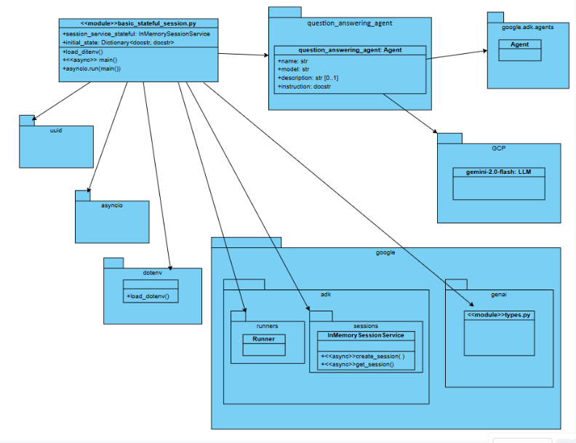
Class Diagram
Notes:
Step-by-Step Breakdown¶
User Input: The User sends a query (e.g., "What's the capital of France?").
Runner Starts: Runner.run_async begins. It interacts with the SessionService to load the relevant Session and adds the user query as the first Event to the session history. An InvocationContext (ctx) is prepared.
Agent Execution: The Runner calls agent.run_async(ctx) on the designated root agent (e.g., an LlmAgent).
LLM Call (Example): The Agent_Llm determines it needs information, perhaps by calling a tool. It prepares a request for the LLM. Let's assume the LLM decides to call MyTool.
Yield FunctionCall Event: The Agent_Llm receives the FunctionCall response from the LLM, wraps it in an Event(author='Agent_Llm', content=Content(parts=[Part(function_call=...)])), and yields or emits this event.
Agent Pauses: The Agent_Llm's execution pauses immediately after the yield.
Runner Processes: The Runner receives the FunctionCall event. It passes it to the SessionService to record it in the history. The Runner then yields the event upstream to the User (or application).
Agent Resumes: The Runner signals that the event is processed, and Agent_Llm resumes execution.
Tool Execution: The Agent_Llm's internal flow now proceeds to execute the requested MyTool. It calls tool.run_async(...).
Tool Returns Result: MyTool executes and returns its result (e.g., {'result': 'Paris'}).
Yield FunctionResponse Event: The agent (Agent_Llm) wraps the tool result into an Event containing a FunctionResponse part (e.g., Event(author='Agent_Llm', content=Content(role='user', parts=[Part(function_response=...)]))). This event might also contain actions if the tool modified state (state_delta) or saved artifacts (artifact_delta). The agent yields this event.
Agent Pauses: Agent_Llm pauses again.
Runner Processes: Runner receives the FunctionResponse event. It passes it to SessionService which applies any state_delta/artifact_delta and adds the event to history. Runner yields the event upstream.
Agent Resumes: Agent_Llm resumes, now knowing the tool result and any state changes are committed.
Final LLM Call (Example): Agent_Llm sends the tool result back to the LLM to generate a natural language response.
Yield Final Text Event: Agent_Llm receives the final text from the LLM, wraps it in an Event(author='Agent_Llm', content=Content(parts=[Part(text=...)])), and yields it.
Agent Pauses: Agent_Llm pauses.
Runner Processes: Runner receives the final text event, passes it to SessionService for history, and yields it upstream to the User. This is likely marked as the is_final_response().
Agent Resumes & Finishes: Agent_Llm resumes. Having completed its task for this invocation, its run_async generator finishes.
Runner Completes: The Runner sees the agent's generator is exhausted and finishes its loop for this invocation.

Slide 36
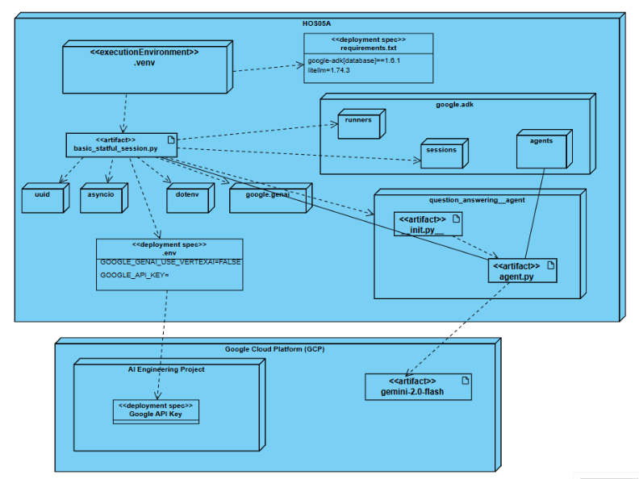
Deployment Diagram
Notes:
Step-by-Step Breakdown¶
User Input: The User sends a query (e.g., "What's the capital of France?").
Runner Starts: Runner.run_async begins. It interacts with the SessionService to load the relevant Session and adds the user query as the first Event to the session history. An InvocationContext (ctx) is prepared.
Agent Execution: The Runner calls agent.run_async(ctx) on the designated root agent (e.g., an LlmAgent).
LLM Call (Example): The Agent_Llm determines it needs information, perhaps by calling a tool. It prepares a request for the LLM. Let's assume the LLM decides to call MyTool.
Yield FunctionCall Event: The Agent_Llm receives the FunctionCall response from the LLM, wraps it in an Event(author='Agent_Llm', content=Content(parts=[Part(function_call=...)])), and yields or emits this event.
Agent Pauses: The Agent_Llm's execution pauses immediately after the yield.
Runner Processes: The Runner receives the FunctionCall event. It passes it to the SessionService to record it in the history. The Runner then yields the event upstream to the User (or application).
Agent Resumes: The Runner signals that the event is processed, and Agent_Llm resumes execution.
Tool Execution: The Agent_Llm's internal flow now proceeds to execute the requested MyTool. It calls tool.run_async(...).
Tool Returns Result: MyTool executes and returns its result (e.g., {'result': 'Paris'}).
Yield FunctionResponse Event: The agent (Agent_Llm) wraps the tool result into an Event containing a FunctionResponse part (e.g., Event(author='Agent_Llm', content=Content(role='user', parts=[Part(function_response=...)]))). This event might also contain actions if the tool modified state (state_delta) or saved artifacts (artifact_delta). The agent yields this event.
Agent Pauses: Agent_Llm pauses again.
Runner Processes: Runner receives the FunctionResponse event. It passes it to SessionService which applies any state_delta/artifact_delta and adds the event to history. Runner yields the event upstream.
Agent Resumes: Agent_Llm resumes, now knowing the tool result and any state changes are committed.
Final LLM Call (Example): Agent_Llm sends the tool result back to the LLM to generate a natural language response.
Yield Final Text Event: Agent_Llm receives the final text from the LLM, wraps it in an Event(author='Agent_Llm', content=Content(parts=[Part(text=...)])), and yields it.
Agent Pauses: Agent_Llm pauses.
Runner Processes: Runner receives the final text event, passes it to SessionService for history, and yields it upstream to the User. This is likely marked as the is_final_response().
Agent Resumes & Finishes: Agent_Llm resumes. Having completed its task for this invocation, its run_async generator finishes.
Runner Completes: The Runner sees the agent's generator is exhausted and finishes its loop for this invocation.

Slide 37
References
Google Agent Development Kit (ADK)
google-adk·PyPI
Gemini models | Gemini API | Google AI for Developers
Brandon Hancock's ADK Crash Course
Module 5: Session, State, & Runner
Brandon Hancock's ADK Masterclass: Build AI Agents & Automate Workflows (Beginner to Pro) (3:12:47)
Module 5: Structured Outputs in ADK (0:53:27– 01:14:13)
Google. (2025). Agent Development Kit. Github.io. https://google.github.io/adk-docs/agents/llm-agents/#guiding-the-agent-instructions-instruction
W3Schools. (2025). JSON. W3schools.com. https://www.w3schools.com/js/js_json.asp
Pydantic. (2020). Welcome to Pydantic - Pydantic. Pydantic.dev. https://docs.pydantic.dev/latest/
‌

Slide 38

Q&A

